Slide 1

Finding the nearest Food court
By
Koushik Reddy (2010030027)
Chaitanya (2010030045)
Soumith (2010030097)
Subramanyam (2010030167)
Under the guidance of
(Deepthi Kalavala)

Slide 2
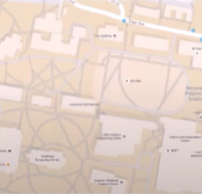
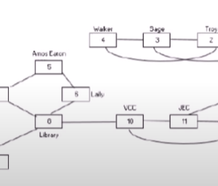
Problem statement and domain
The minimum set cover problem is considered as a NP-Hard Problem. Our main objective is to find the minimum number of food courts to cover all the buildings in the particular street/area.Because nowadays people will travel to different places to get their food when needful. So we will pick some buildings and formulate the problem of opening food courts of these selected buildings. We connect these two with threshold time based on distance between the buildings.

Slide 3
Existing solutions/ Naïve solutions Integer linear programming for Set cover Problems
The activities to be included should be distinctly identifiable and measurable in quantitative terms, for instance, the products included in a production planning problem and all the activities can’t be measured in quantitative terms for example if the food court is closed at one day then we cannot predict that it is closing all the days.
While solving an LP model, there is no guarantee that we will get integer valued solutions.

Slide 4
Proposed Algorithm Design Technique
The technique we are going to use in this application is greedy algorithm. It will add one set at a time to the set cover until every element in X is covered by at least one set
It will give best polynomial time to cover the more number of buildings with lesser number of food courts.
In this application it is more optimal when compared to previous algorithms.

Slide 5
Data Structures needed
Array list
Hash Set
LinkedHashMap

Slide 6
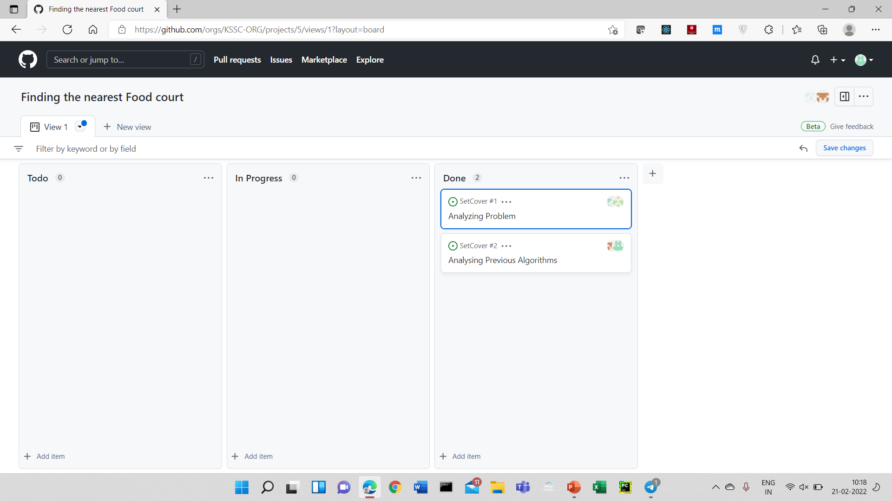

Github setup
https://github.com/KSSC-ORG/SetCover.git

Slide 7
Division of work among the group members
Identifying the Problem Statement –Chaitanya
Identifying the existing solution – Subramanyam
Identifying the algorithm – Koushik
Data structures and github - Soumith

